Slide 1





Welcome to our
Shiny R Workshop
Presenters:
Carlos Hernandez;
Gustavo Santiago;
Ignacio Ciampitti and
Pedro Cisdeli

Slide 2
Agenda
What is Shiny?
Preparation;
Layout;
Basic structure of a Shiny App;
Importing data;
Widgets;
Showing information;
Reactivity;
Installation;
Hands-on using flexdashboard;
Advanced features;
Q&A

Slide 3

What is Shiny?
Framework that uses R as the primary developing language

Slide 4
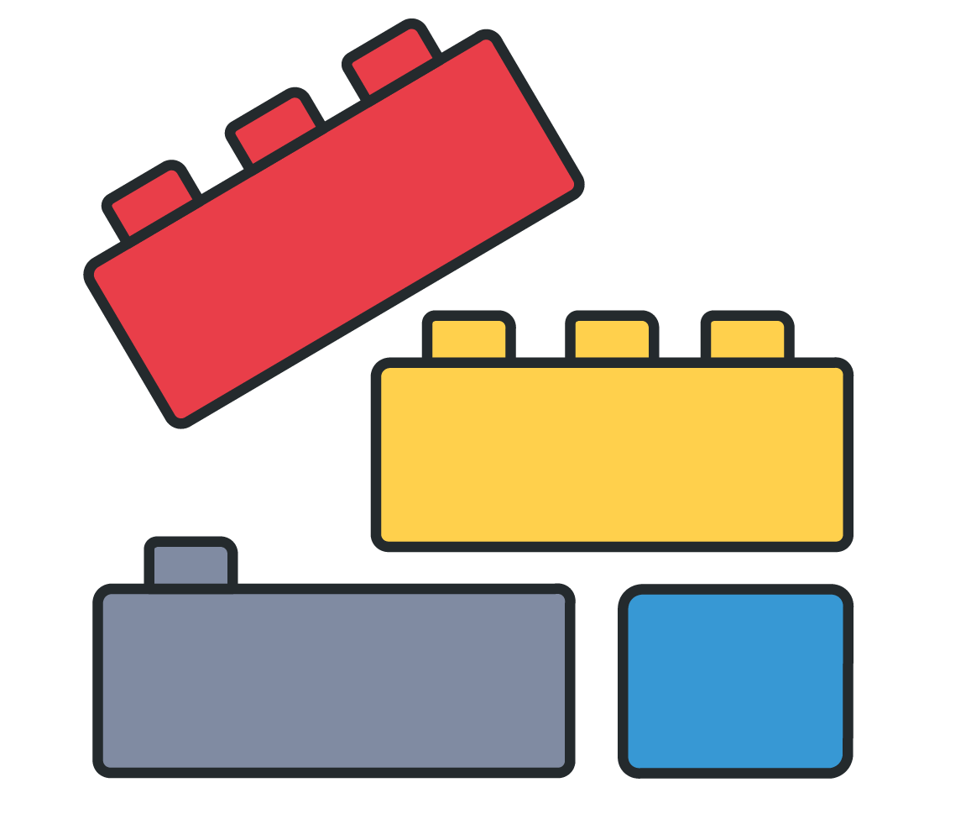
What is Shiny?
Framework that uses R as the primary developing language
What is a framework?

Slide 5


What is Shiny?
Framework that uses R as the primary developing language
What is a framework?
Shiny combines front with back ends

Slide 6


What is Shiny?
Framework that uses R as the primary developing language
What is a framework?
Shiny combines front with back ends
Develop web applications easier than other frameworks
Shiny allows you to develop simple yet powerful applications using R
Show your research to the public

Slide 7
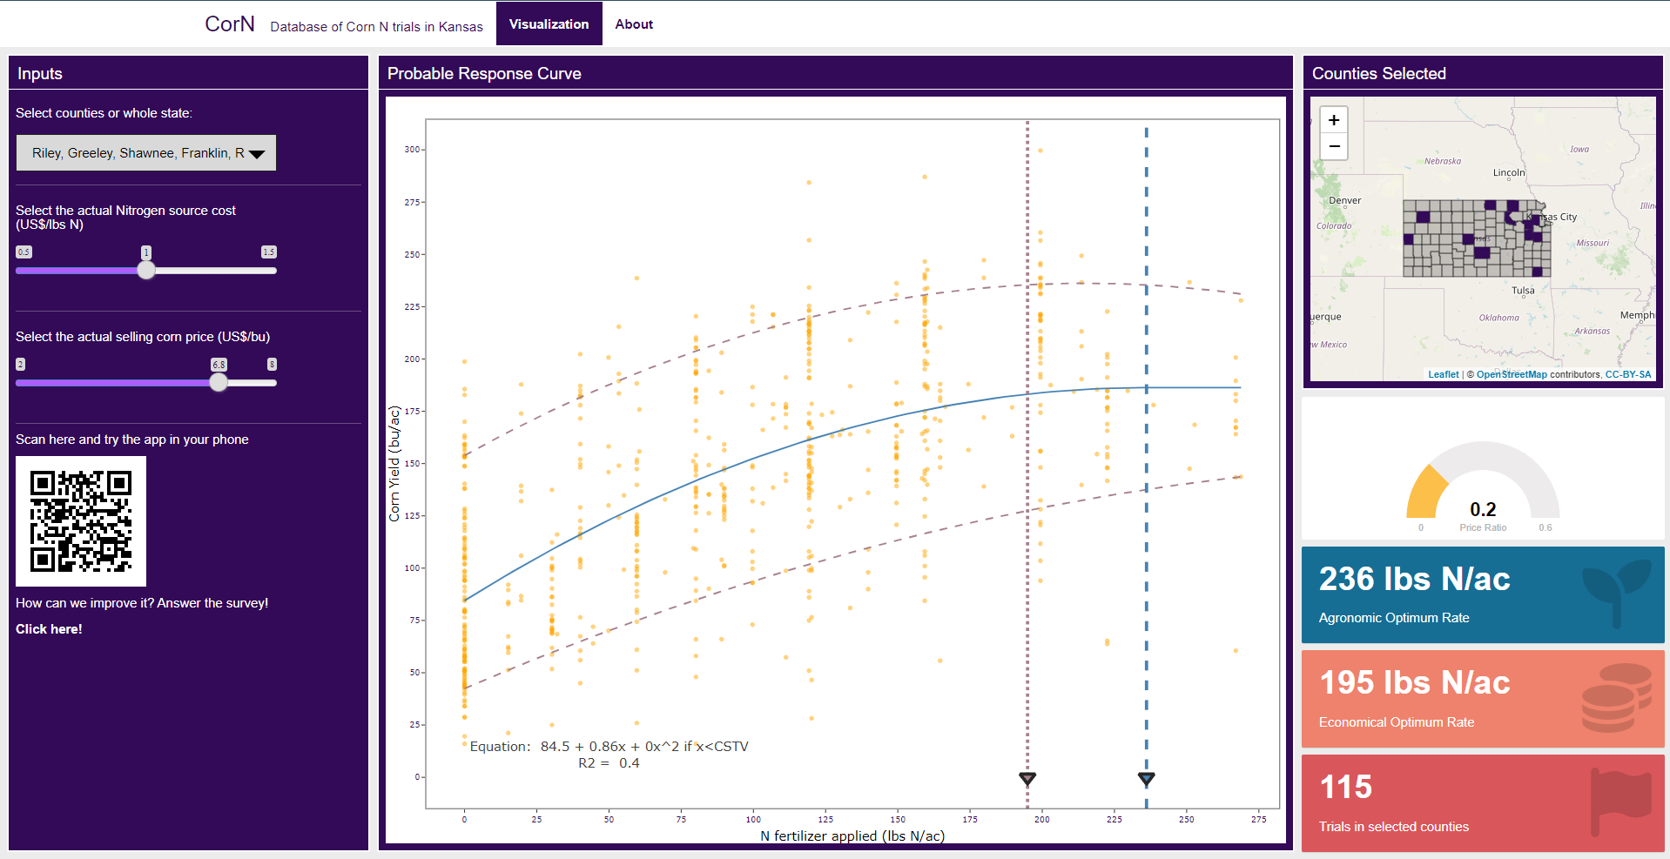
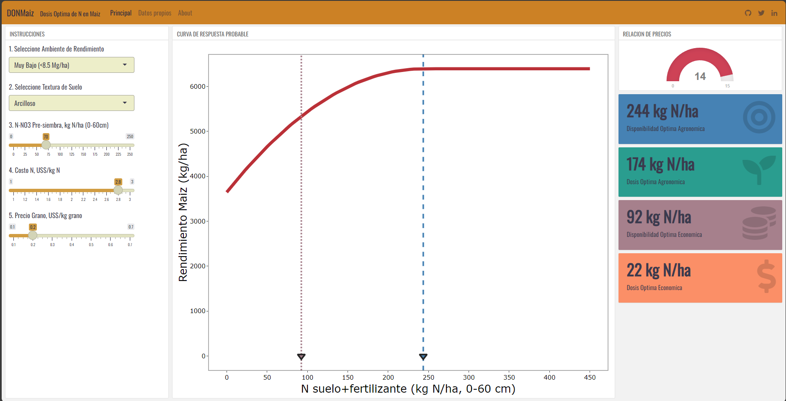
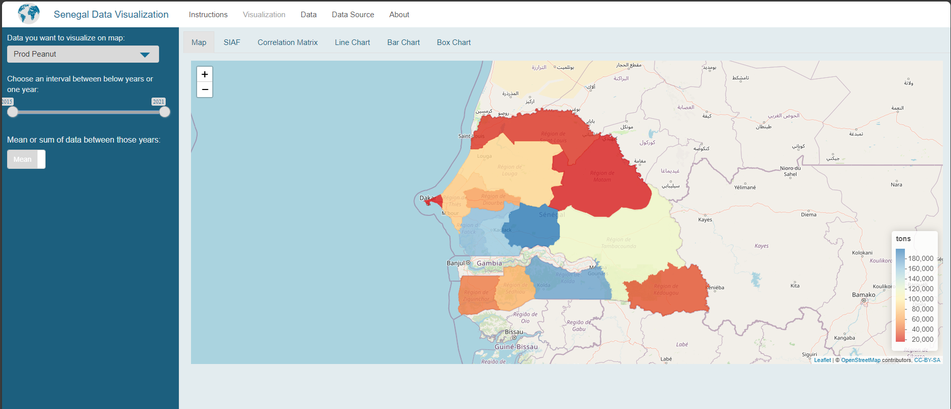
What is Shiny?
Show your research to the public

Slide 8
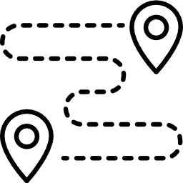
Preparation
The most important step is the first
The first step while developing tools is the planning of it
To plan how to develop a right-to-the-point tool, you have to ask yourself and the team the following questions:

Slide 9
What do my PI or the stakeholders want?
How will the users interact with the data?
How can I deliver the message?
How will be the design of my application?

Slide 10




Layout
Layout planning tools
Many possible layouts using flexdashboard:
Sample layouts • flexdashboard (rstudio.com)
Using other packages, the layouts are endless

Slide 11
Basic Structure of a Shiny App
In flexdashboard, we use Rmd.
Rmd is a document format where is possible to write and run R in chunks and use it to prepare HTML, PDF, or Word Documents.
It uses the following structure:

Slide 12
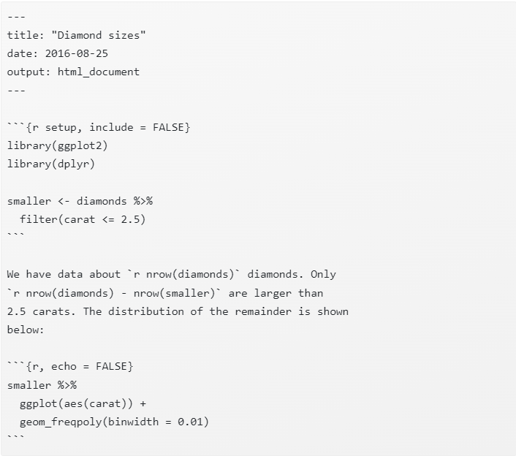
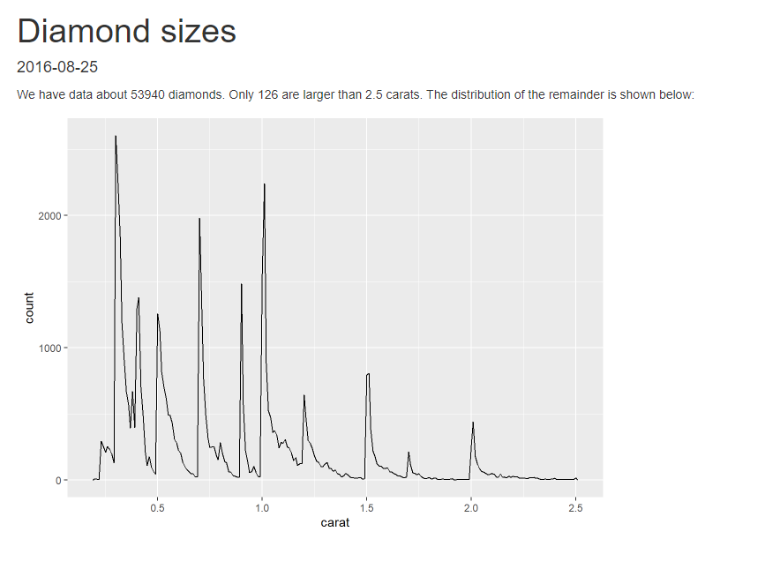
Basic Structure of a Shiny App
Rmd uses the following structure:
Having the following output:

Slide 13
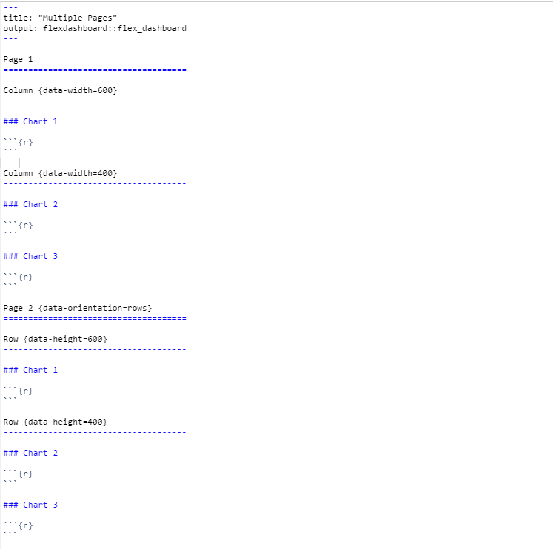
Basic Structure of a Shiny App
Since we can have different layouts, we can have different structures. But they are similar in the sense of:
The page title and informing that the output is a flexdashboard

Slide 14
Basic Structure of a Shiny App
Since we can have different layouts, we can have different structures. But they are similar in the sense of:
Everything within this structure will be in a page

Slide 15
Basic Structure of a Shiny App
Since we can have different layouts, we can have different structures. But they are similar in the sense of:
Everything within this structure will be in a column

Slide 16
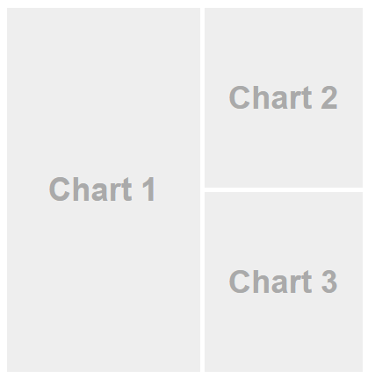
Basic Structure of a Shiny App
Since we can have different layouts, we can have different structures. But they are similar in the sense of:

Slide 17
Basic Structure of a Shiny App
Since we can have different layouts, we can have different structures. But they are similar in the sense of:
Everything within this structure will be in a row

Slide 18
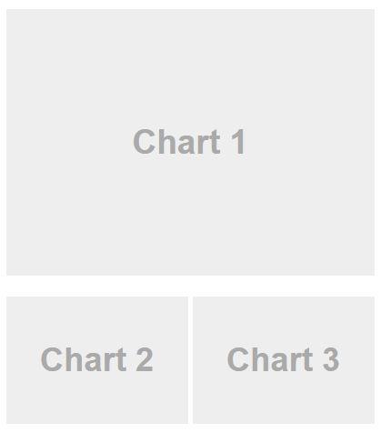
Basic Structure of a Shiny App
Since we can have different layouts, we can have different structures. But they are similar in the sense of:

Slide 19
Importing data
The most common approach is to store your data in a variable when the app starts:
data <- read.csv(“data.csv”)
It is also possible to retrieve data from Google Excel sheets
For bigger datasets or to retrieve data from online repositories it is recommended to use APIs

Slide 20
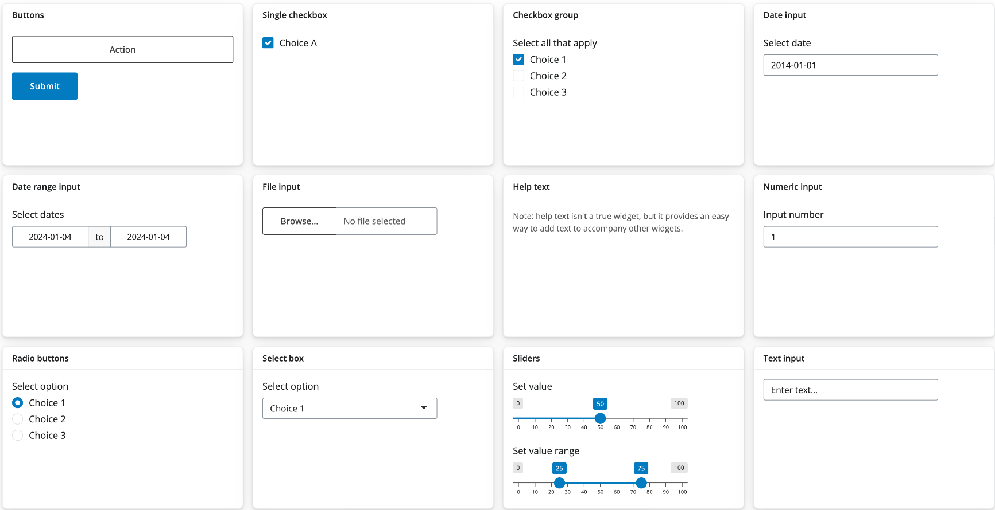
Widgets
Basic widgets in Shiny:
One more library to pay attention: shinyWidgets (shinyWidgets (dreamrs.fr))

Slide 21
Showing information
Text
Warning or providing information due to inputs
Cards
Display right-to-the-point information
Plots
ggplot() and plotly() libraries
Images
Display images based on user inputs
Maps
Choropleth and raster

Slide 22
Reactivity
Reactivity is what allows a website to be dynamic and interact with the user
In Shiny, the main reactivity functions are used depending on the desired output:
renderText({function})
Create a text output
renderPlot ({function})
Create plots
renderUI({function})
Create reactive widgets, cards, and many other outputs

Slide 23
Reactivity
To retrieve the data user input on the widgets, it is used:
sliderInput(inputId, …)
creating a widget
input$[inputId]
retrieving the value that the user has inputted
To create the output responses, it is used:
uiOutput(outputId, …)
Displaying the output response
output$[outputId]
Creating the output response

Slide 24

Confusing? Yes, I know…
Let me provide you an example

Slide 25
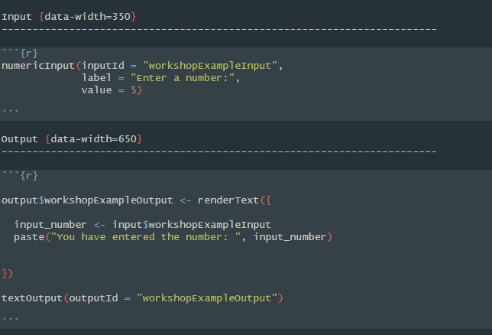
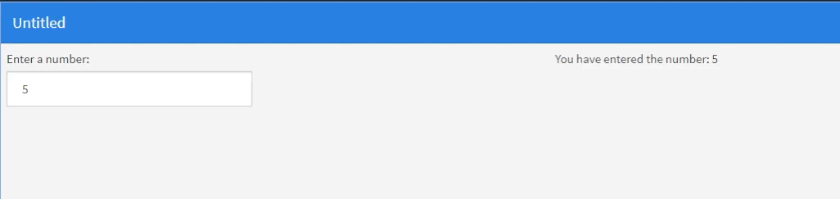

Slide 26
Reactivity
More advanced reactivity processes:
reactive({function})
Variables created here can be used elsewhere
observe({function})
Variables created here can NOT be used elsewhere
observeEvent({function})
Best used with triggers (i.e. buttons)

Slide 27
Installation
Have R and RStudio installed in your computer
Install Shiny by running in the command line:
install.packages("shiny")
Install flexdashboard package by running in the command line:
install.packages(“flexdashboard")

Slide 28
Hands-on
Check the template with us

Slide 29
Hands-on
Time to practice

Slide 30
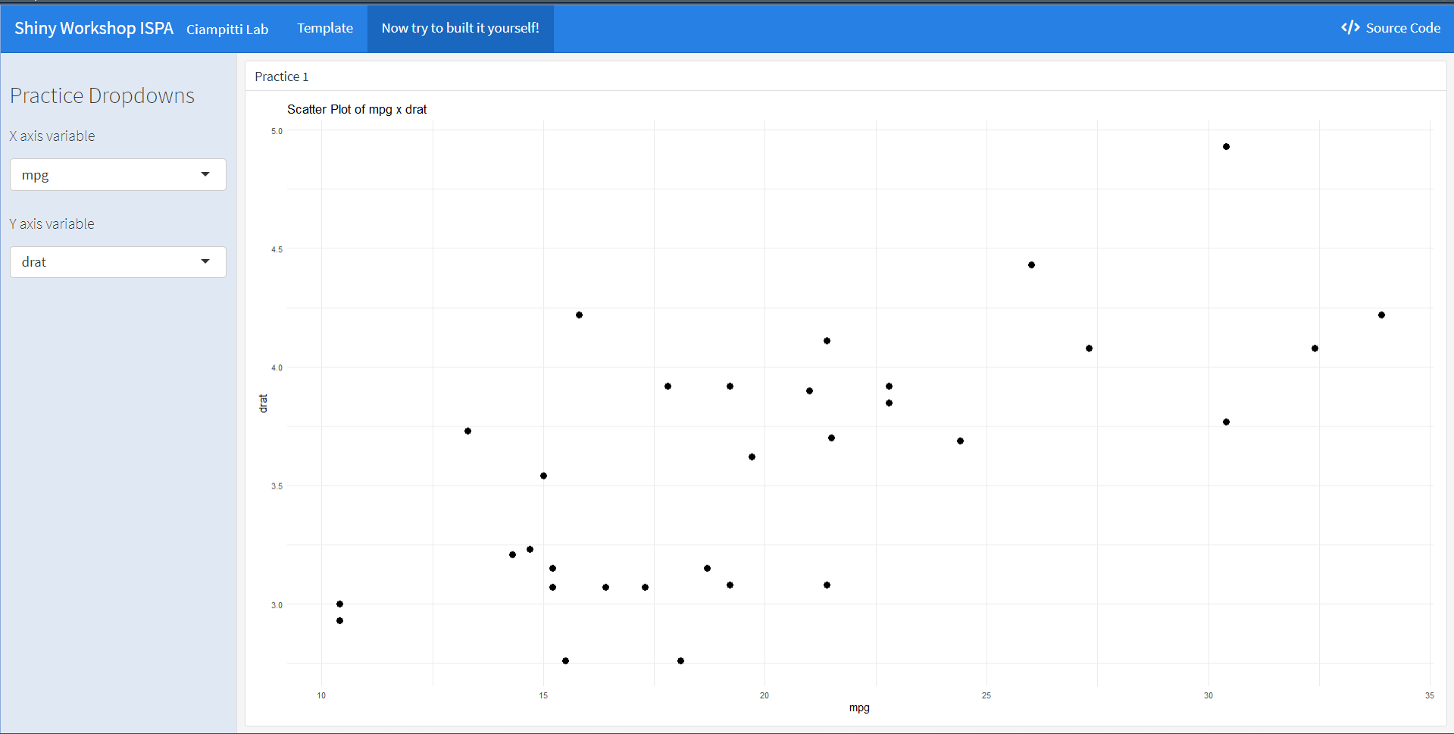
Hands-on
We are going to build this together:

Slide 31
Hands-on
Lets go step-by-step:
On:
<!-- Create a sidebar -->
Replace to:
Inputs {.sidebar}
-------------------------------------
On:
<!-- Create a title for the set of controls -->
Replace to:
### Practice Dropdowns
selectInput(
inputId = "practice_x_var",
label = "X axis variable",
choices = names(cars_df),
selected = "mpg“
)
On:
# Create the first input for the X variable
Replace to:
selectInput(
"practice_y_var",
label = "Y axis variable",
choices = names(cars_df),
selected = "hp"
)
On:
# Create the second input for the Y variable
Replace to:

Slide 32
Hands-on
Lets go step-by-step:
Column {data-width=600}
-------------------------------------
On:
<!-- Create a column for the plot -->
Replace to:
On:
<!-- Create a title for the plot -->
Replace to:
### Practice 1
output$practice_plot <- renderPlot({
ggplot(cars_df,
aes_string(x = input$practice_x_var, y = input$practice_y_var))+
geom_point(size = 3) +
labs(title = paste("Scatter Plot of", input$practice_x_var, "x", input$practice_y_var)) +
theme_minimal()
})
On:
# Create the output object
Replace to:
On:
# Display the output
Replace to:
plotOutput("practice_plot")

Slide 33
Advanced features
It is possible to use different styles on your app:
Theming flexdashboard • flexdashboard (rstudio.github.io)
Try different shiny formats, such as pure shiny:
Shiny - Welcome to Shiny (posit.co)
Add custom designs in your app with HTML, CSS, and JavaScript
Deploy your app on shinyapps.io:
Shiny - Getting started with shinyapps.io (posit.co)
Deploy your app on AWS, Azure, Google or other web service:
The Ultimate Guide to Deploying a Shiny App on AWS - Charles Bordet
Create a library from your app:
ThinkR-open/golem: A Framework for Building Robust Shiny Apps (github.com)

Slide 34
Advanced features
Remember:
Practice, patience, and practice

Slide 35
Q&A
Thank you for attending
Any questions?

Slide 36
Shiny R Workshop
Presenters:
Carlos Hernandez;
Gustavo Santiago;
Ignacio Ciampitti and
Pedro Cisdeli

